Slide 1
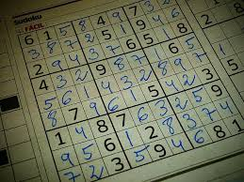
Sudoku Solving Algorithm and Visualization
By
Shivani Dhanasamy
Zimple Kabariya
Reshma Barvin Shahul Hameed Ammanullah

Slide 2
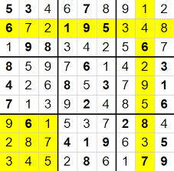
What is Sudoku ?
Sudoku is a fun and brain-wrecking puzzle .
Rules are very simple.
No same number in row or column or block.

Slide 3
Why Sudoku Solving Algorithm?
We choose this algorithm not with the sole purpose of solving the puzzle but to help the maker create a well-posed Sudoku grid.
So our algorithm helps the person to check if a grid is solvable and if it has more than one solution.
Solving sudoku has always been a time consuming task irrespective of its difficulty level. Using this algorithm developers or makers of the game can spend less time on developing or finding the solution of the game.

Slide 4
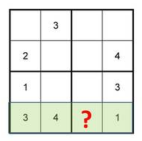
Naïve Algorithm
The naïve algorithm also known as elimination method is to generate all possible values to fill the empty cells.
If possibility set has only 1 value then its enter in the grid else it move to next empty cell.
We will iterate this till we find the correct placement for all cell. This is a very tedious process.
Possible values: 1,2
Possible values: 4

Slide 5
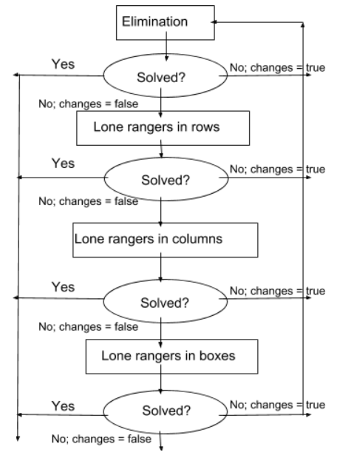
Crook Algorithm
Elimination: a cell only has one possible value left.
Lone rangers: a number can only fit in one cell in a row or column or block.

Slide 6
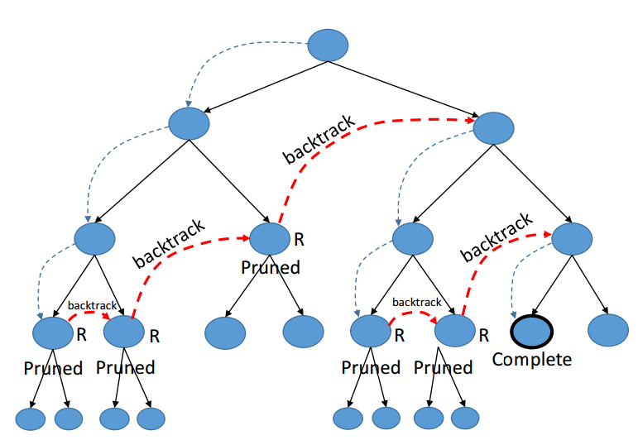
Backtracking
Backtracking is a technique for solving problems recursively by building a solution incrementally one step at a time.
We proceed by discarding the solution paths that fail to satisfy the constraints at any point.

Slide 7
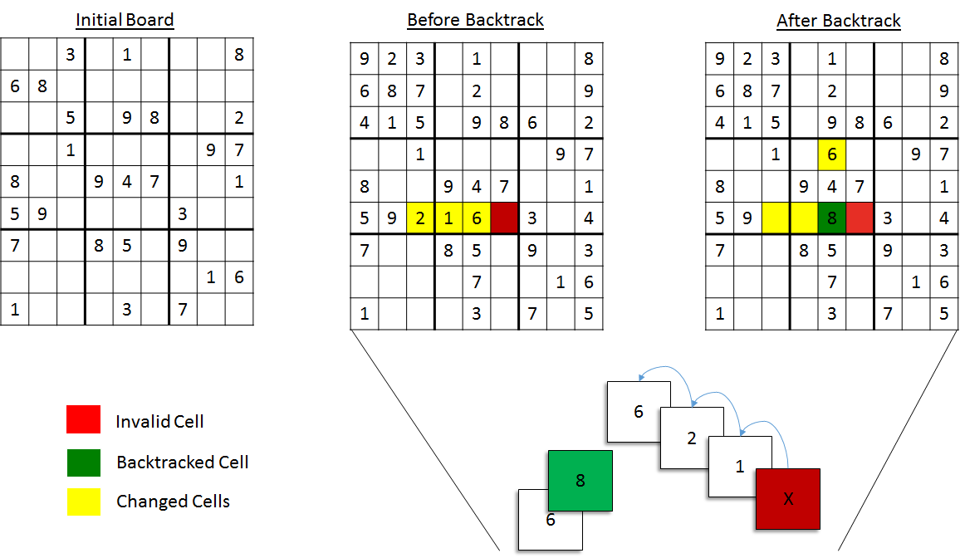
Backtracking
Assign possible value to the empty cells.
We begin traversing from the cell with fewest values in the possibility set.
But before doing so always check if that solution is safe or not. i.e. Violating any constraints or not.
Repeat the above process recursively checking whether it leads to a solution or not after each assignment.

Slide 8
Visualization
The setTimeout() method calls a function after a specified number of milliseconds.

Slide 9
References
https://mpardesh.github.io/halide-bilateral-filtering-website/finalreport
https://imgur.com/gallery/0sfWi
http://brutalsimplicity.github.io/assets/sudoku/sudoku-backtrack.png
https://hackernoon.com/sudoku-and-backtracking-6613d33229af

